Slide 1


Natural Language Processing
Sentiment Analysis - Dow Jones(DJIA) stock using News Headlines
Under the guidance of
Rajeshwari S.B.

Slide 2

Team
1MS19IS050 Ishan Sharma
1MS19IS061 Kuldeep Pancholi
1MS19IS069 Mehwish Najam

Slide 3
ACKNOWLEDGEMENT
WE have taken efforts in this presentation. However, it would not have been possible without the kind support and help of many individuals and organizations.WE would like to extend OUR sincere thanks to all of them.
We are highly indebted to RIT BANGALORE for its guidance and constant supervision as well as for providing necessary information regarding the project & also for its support in completing the presentation.
We would like to express our gratitude towards our parents & our NLP teacher for their kind cooperation and encouragement which help us in completion of this presentation.
Our thanks and appreciations also goes to our colleagues in developing the presentation and people who have willingly helped us out with their abilities.

Slide 4

Contents
Problem Statement
Dataset Description
Concepts of NLP Used
Model Building
Predictions

Slide 5
Problem Statement
We created a model which will actually analyze stock price using News Headline.
There are various kinds of news articles and based on that the stock price fluctuates.
We analyzed the news heading using sentiment analysis using NLP and then we predicted the stock will increase or decrease.
It is all about stock sentiment analysis.

Slide 6
Dataset Description
The dataset in consideration is a combination of the world news and stock price shifts available on kaggle.
There are 25 columns of top news headlines for each day in data frame.
Data ranges from 2008 to 2016 and the data from 2000 to 2008 was scraped from Yahoo finance.
Labels are based on the Dow Jones Industrial average stock index.
Class 1 - The stock price increased.
Class 2 - The stock price stayed the same or decreased.

Slide 7
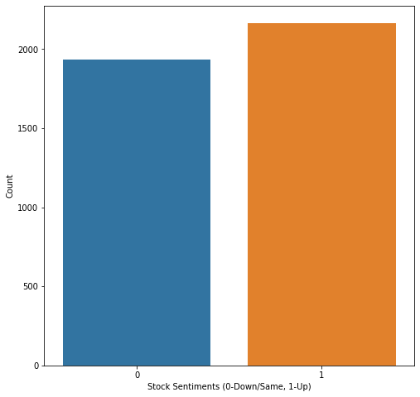
Visualizing the count of 'Label' column from the dataset

Slide 8
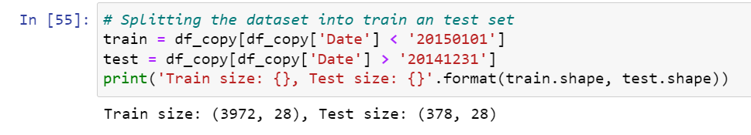
Splitting the dataset

Slide 9
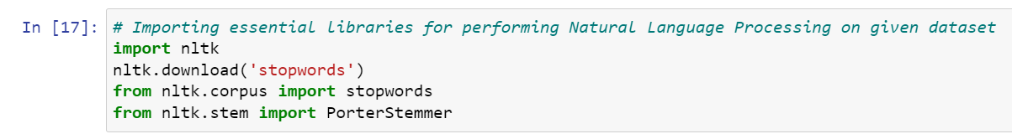
Important NLP Libraries Used

Slide 10
Concepts of NLP Used
Removing Punctuation and Special Character.
Renaming columns, Converting the entire text to lower case and Joining all the columns.
Creating corpus of train and test dataset which includes
Tokenizing the news-title by words
Removing the stopwords
Stemming the words and Joining the stemmed words
Building a corpus of news-title
Creating Bag of Words Model

Slide 11
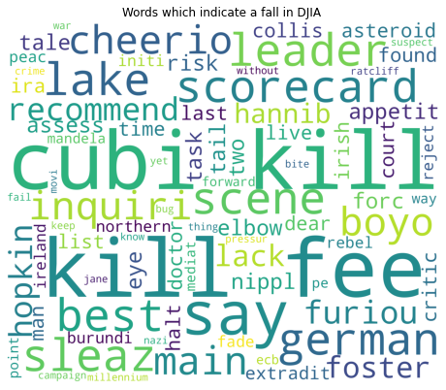
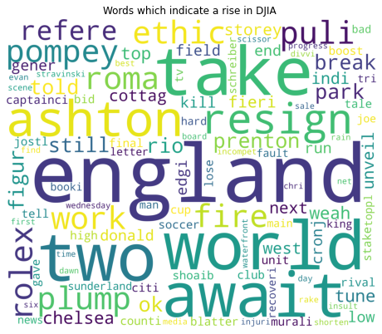
Word Cloud for Down and Up Words

Slide 12
Model Building
We have used two Machine Learning model with the use of sklearn Library.
Logistic Regression.
Multinomial Naive Bayes.

Slide 13
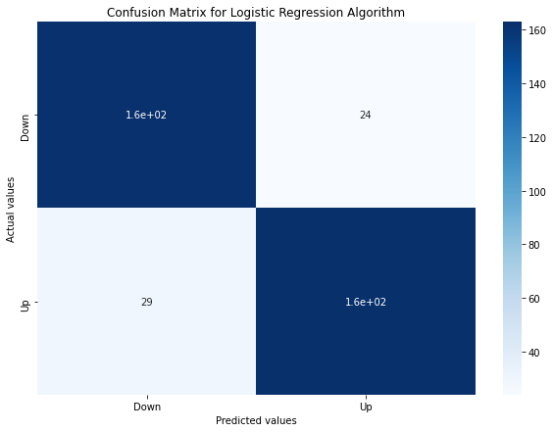
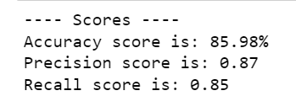
Logistic Regression and scores

Slide 14

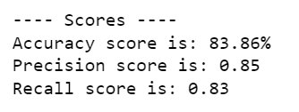
Multinomial Naive Bayes and scores

Slide 15
Predictions
We have used Logistic Regression model for making predictions as accuracy score of Logistic Regression ( 85.98% ) is better than Multinomial Naive Bayes ( 84.13%).
We Pick a random day and select one news headline from the top25 from the test dataset and then make the predictions.
Case 1 - Prediction: The stock price will go up!
Case 2 - Prediction: The stock price will remain the same or will go down.

Slide 16
Predictions (For Example)

Slide 17
Predictions (For Example)

Slide 18
References
https://www.analyticsvidhya.com/blog/2021/05/stock-price-movement-based-on-news-headline/
https://www.kaggle.com/aaron7sun/stocknews
https://www.youtube.com/channel/UCNU_lfiiWBdtULKOw6X0Dig (Krish Naik)
https://www.kdnuggets.com/2019/01/solve-90-nlp-problems-step-by-step-guide.html

Slide 19
Thank you

